Slide 1

TX References
Eliot Turner

Slide 2
Our Proposed Architecture
Spi0
(MISO, MOSI, CLK)
Chip Select Legend
ADAR1000 #1
CS0
CS1
CS2
ADAR1000 #2
Aux ADAR1000
ADF4159 PLL

Slide 3
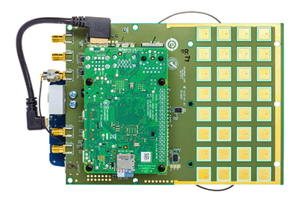
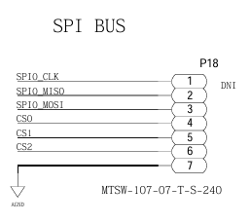
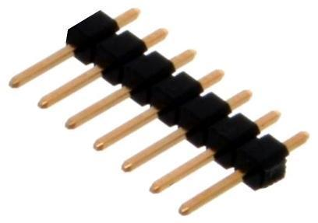
Necessary Hardware Modification
[2]
[1]
[3]

Slide 4
Device Tree Changes
&spi0 {
/* Onboard ADAR #1 */
/* ADAR #2 + AUX */
adar1000@1 {
compatible = "adi,adar1000";
reg = <1>;
#address-cells = <1>;
#size-cells = <0>;
adar1000_1@0 {
label = "BEAM1";
reg = <0>;
adi,phasetable-name = "adar1000_std_phasetable";
};
adar1000_1@1 {
label = "BEAM2";
reg = <1>;
adi,phasetable-name = "adar1000_std_phasetable";
};
};
};
Proposed Changes
Existing Device Tree
csb1_chip0
On Auxiliary ADAR1000:
ADDR1 = LOW
ADDR0 = HIGH
csb1_chip1

Slide 5
Image Citations
[1] Analog Devices, “EVAL-CN0566-RPIZ KIT - Angle View,” on *CN0566 Circuit Note | Circuits from the Lab*, https://www.analog.com/en/resources/reference-designs/circuits-from-the-lab/cn0566.html#rd-overview (accessed Feb. 10, 2026).
[2] Analog Devices, “EVAL-CN0566-RPIZ Phased Array Development Kit Schematic,” on *CN0566 Circuit Note | Circuits from the Lab*, https://www.analog.com/en/resources/reference-designs/circuits-from-the-lab/cn0566.html#rd-overview (accessed Feb. 10, 2026).
[3] PE Connectors, “Pin Headers Straight 1x Row .100 Image,” *PE Connectors – Pin Headers Straight 1x Row .100*, https://www.peconnectors.com/pin-headers-straight-1x-row-.100/hws9166/ (accessed Feb. 10, 2026).

